Slide 1
NYC Traffic Fare Levels and Volume
Jonathan Hernandez
CUNYSPS DATA698 Fall 2019 Research Project

Slide 2
Introduction and Motivation
Throughout NYC, there are many bridges and tunnels to get around the city. However, over the years, traffic congestion has been a common problem and there have been several ideas proposed by the MTA.
In this project I will use Python to look at data that shows hourly traffic for 10 different kinds of bridges and tunnels. I will append simulated fare prices to the dataset and run ML algorithms that fit a model for predicting traffic volume.
I will then append various fare prices and increment them similar to how the historical prices of each toll and bridge were.
We can see this simulation as a way that maximizes fare usages but minimizes traffic congestion.

Slide 3
Literature Review
Several posts and ideas have been presented regarding congestion pricing such as nyc.streetsblog.org, gothamist.com and, silive.com
According to the nyc.streetsblog.org variable pricing at MTA bridges and tunnels would ease traffic for example, by encouraging some drivers to shift their trips to off-peak times. Such a change would decrease traffic by about 4.9- 11.8 percent. Other options mentioned that charging more during peak hours and less during off-peak times.
The blog site silive.com shows that implementing nyc congestion pricing can also help to improve travel speeds. Other pricing models mentioned there are the flat all day price and low/moderate high peak period price.
Finally, the site gothamist.com also reports that MTA and the city have decided to apply congestion pricing in the year 2020-2021.

Slide 4
Data Sources and Summary
The dataset in question can be found here
https://www.kaggle.com/new-york-state/nys-metropolitan-transport-authority-mta-data
It is a csv file of NYC bridge and tunnel tolls from 2010 - 2019 that shows how many vehicles went through either paying by cash or via EZ - pass.
Each row shows how many vehicles passed through each toll plaza per hour and whether traffic was inbound or outbound.

Slide 5
Features and their description
The following are the features and their description:
• Plaza ID: numerical ID that represents each toll plaza.
(Note: 1-11 are the original historical values before tolling switchover dates and 21-30 are values after the road tolling switch over date (around 2017)
• Date: Date of the measurement taken of traffic
• Hour: The hour associated with the data
• Direction: Direction of traffic (Inbound or Outbound)
• # Vehicles – E-Zpass: Number of vehicles that pass through each bridge or tunnel
• # Vehicles – Cash/Vtoll – Number of vehicles that paid in cash

Slide 6
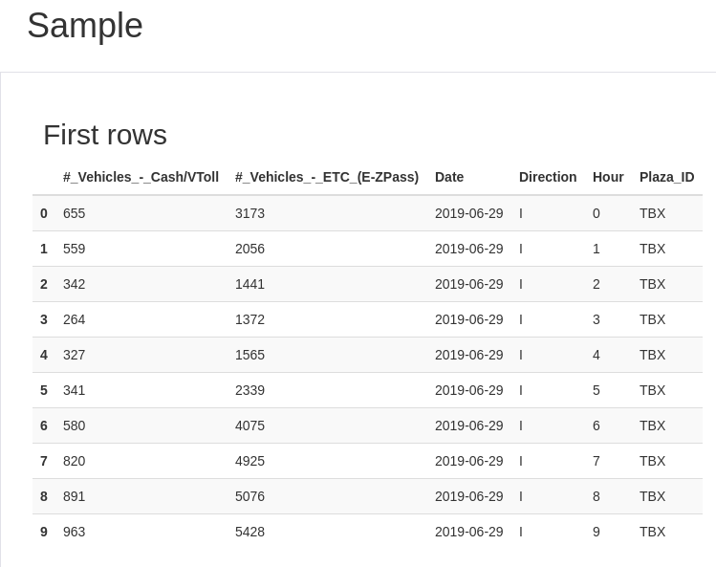
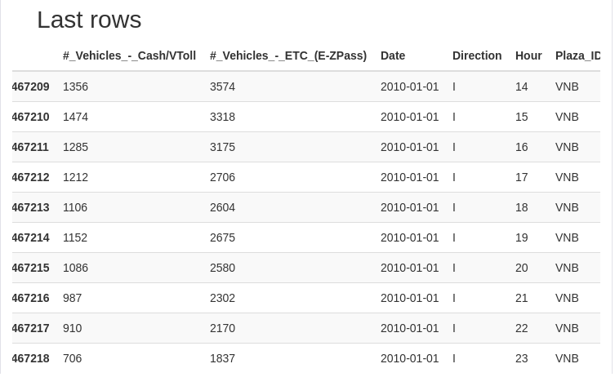
Exploratory Data Analysis
Python has a module called ‘pandas_profiling’ that has a function ProfileReport(<dataset>) that can do EDA on a dataset in a one-liner.

Slide 7
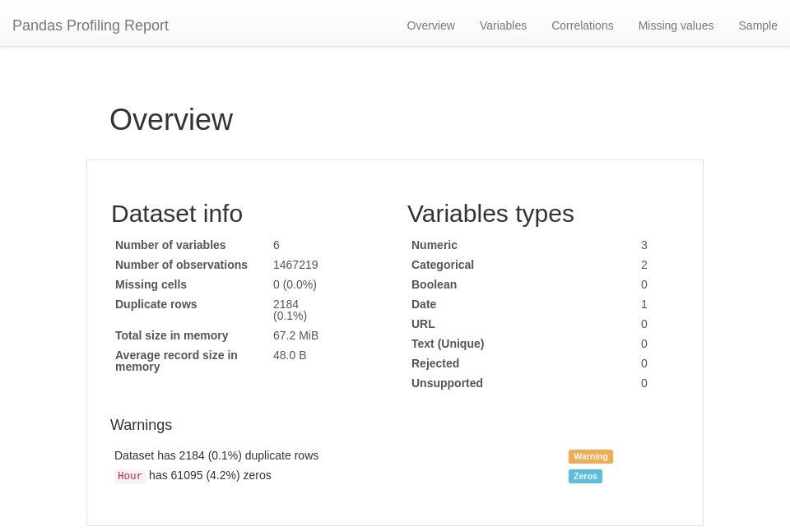
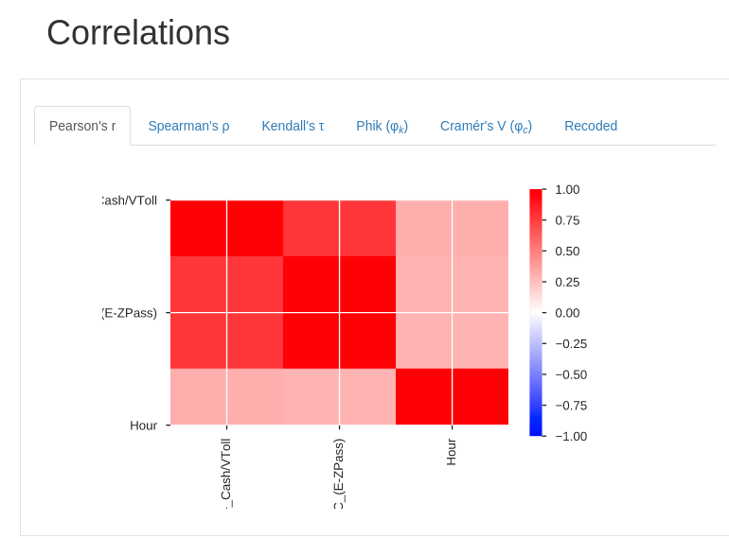
Exploratory Data Analysis (Continued)
Python has a module called ‘pandas_profiling’ that can do EDA on a dataset in a one-liner.

Slide 8
EDA Summary
We see that there are no missing values which can make things easier in our analysis.
Using Pearson’s correlation, there are only positively skewed correlations with strong ones being between the 2 vehicle counts (cash and EZ-pass)

Slide 9
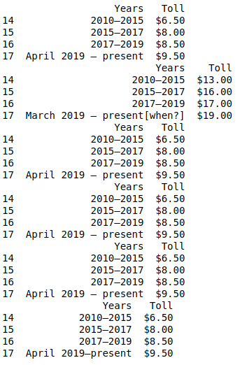
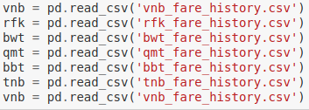
Historical Fare Prices from 2010 - 2019
Looking around on Wikipedia, there are historical prices on majority of bridges and tunnels.
These historical fares will be appended to the data and will be used in regression algorithms.
Below are the historical fares of bridges and tolls except for the Verrazano-Narrows bridge which had nearly double toll prices.
Code to the right shows how the data were loaded and the display of only the years from 2010-2019

Slide 10
Training Machine Learning Regression Algorithms for Predicting Vehicle Volume
With the original fares added, the dataset now contains the fare prices of each bridge and the number of vehicles entering inbound or outbound per hour from 2010 - 2019 and the fare prices.
As we are trying to create a optimization model that minimizes fare prices but can maximize revenue, this will be a regression problem. Regression models will be created for modeling vehicle volume (we’ll include EZ-pass for this project).
Models that will be used will be simple linear regression, elastic net and random forest models.
The dataset will be a training/test split of 70/30
The explanatory variables will be used are the Plaza ID, hour, year, direction and, fare price.
The response variable will be ‘# Vehicles - ETC (E-ZPass)’
Metrics used to pick the best model will be the smallest root mean-squared error and mean absolute error (RMSE and MAE respectively)

Slide 11
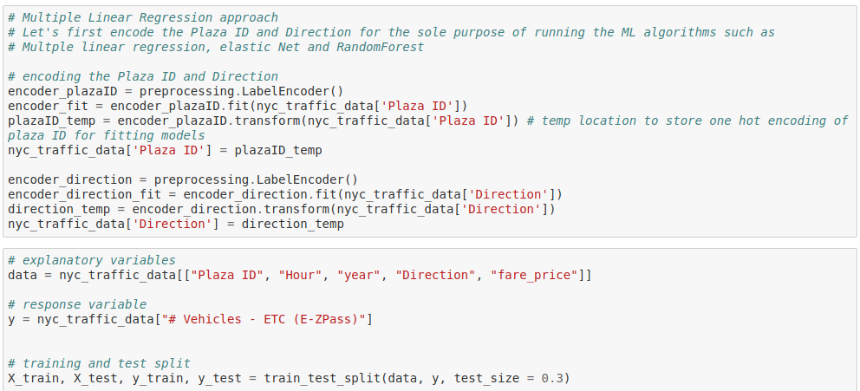
Machine Learning Metric Results
Prepping the data for our models:

Slide 12
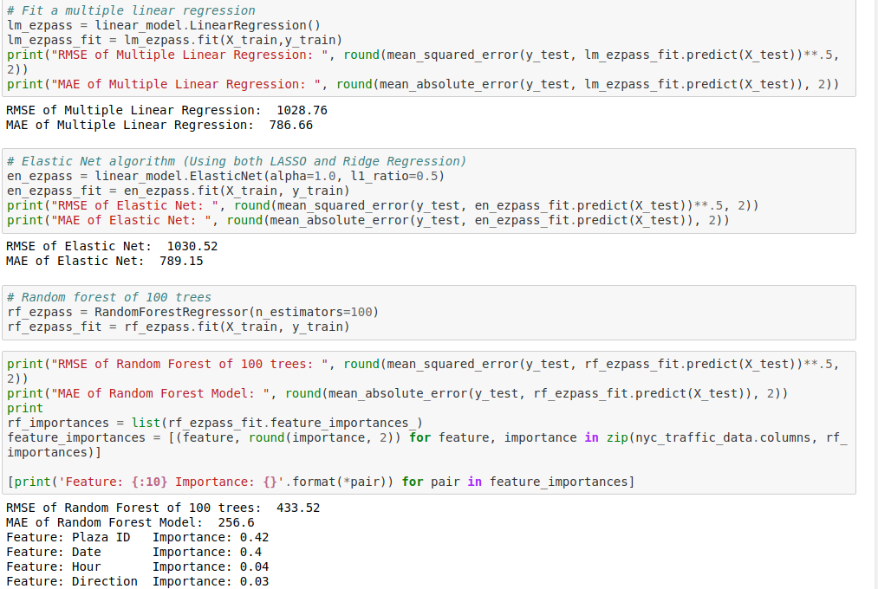
Machine Learning Metric Results (continued)
RMSE and MAE results of linear regression, elastic net and random forest of 100 trees. Based on these metrics, random forest gives the smallest RMSE and MAE and will be used.
Feature importance for the random forest model shows that the Plaza ID and date feature is the most important thing for modeling vehicle volume.
Next, simulated fares from $4.00 to $20 dollars in one dollar increments will be added to the dataset and random forest models will be ran based on each fare price.

Slide 13
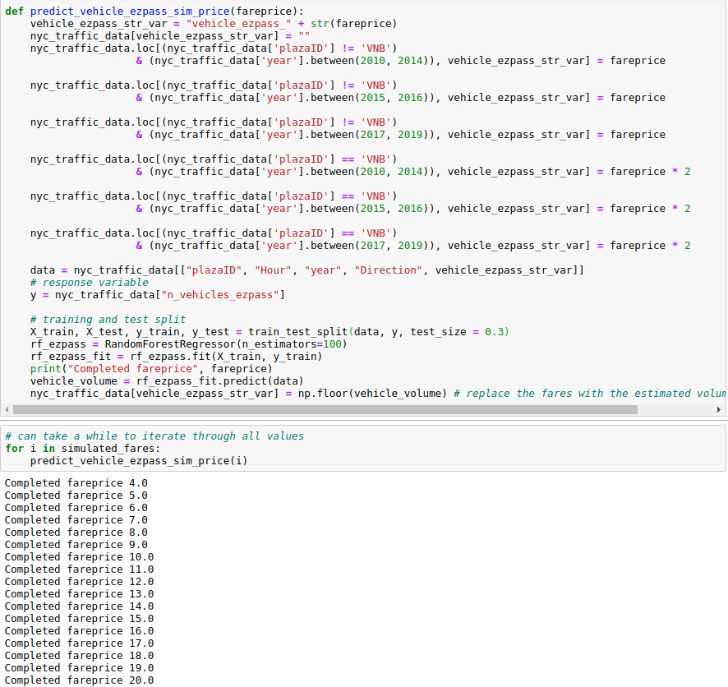
Random Forest Models For Various Simulated Fare Prices
The approach will be for each simulated fare price (4,5,...20), a random forest model will be deployed and create a new variable called ‘vehicle_ezpass_<fare_price>’ that contains predicted vehicle traffic.
The prices can then be graphed/compared to see how vehicle traffic would appear under the circumstances of a possible fare price.

Slide 14
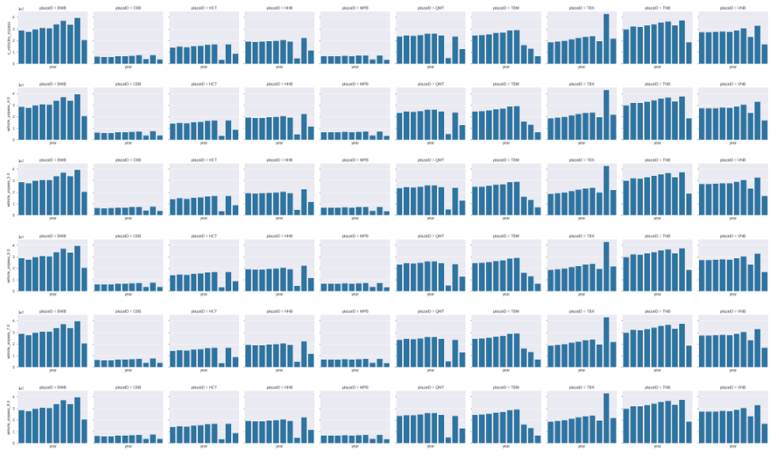
Results and Conclusions
Using this random forest approach and appending simulated fares, prices don’t change much as expected.
Some things to consider and perhaps for future work:
Use a different dataset
Use a different algorithm
Other factors that could make the data more accurate, like co2 emissions, weather, vehicle type and model etc.

Slide 15
References
Varone, Jason. “Variable Pricing at MTA Bridges and Tunnels Would Ease Traffic” StreetsBlog NYC https://nyc.streetsblog.org/2007/09/26/variable-pricing-at-mta-bridges-and-tunnels-would-ease-traffic/ 24 Sept, 2007
Nessen, Stephen. “MTA And City Move Forward On Congestion Pricing” Gothamist https://gothamist.com/news/mta-and-city-move-forward-on-congestion-pricing 19 June, 2019
Bascome, Erik “NYC Congestion Pricing New Report Recommends Variable 2-way Fees” https://www.silive.com/news/2019/09/nyc-congestion-pricing-new-report-recommends-variable-2-way-fees.html 18 Sep, 2019
Dataset Location: https://www.kaggle.com/new-york-state/nys-metropolitan-transport-authority-mta-data

